Slide 1
Welcome do code club week2!

Slide 2
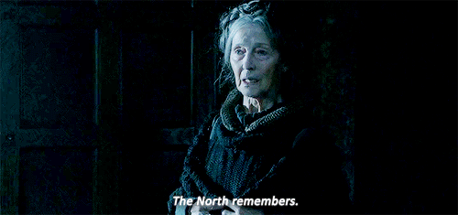
Let’s recap last month’s session

Slide 3
What is a variable?
What is a value?
What is int and what is a float?
What is a string?
What can we do with numbers and what can we do with strings?

Slide 4
Sometimes, we want to deal with several “things” at the same time

Slide 5
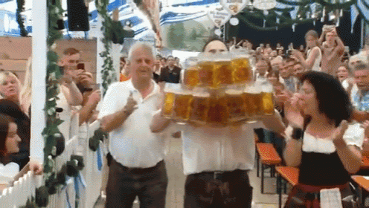
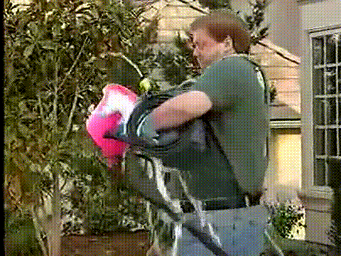
And we may care about their order
Or not

Slide 6
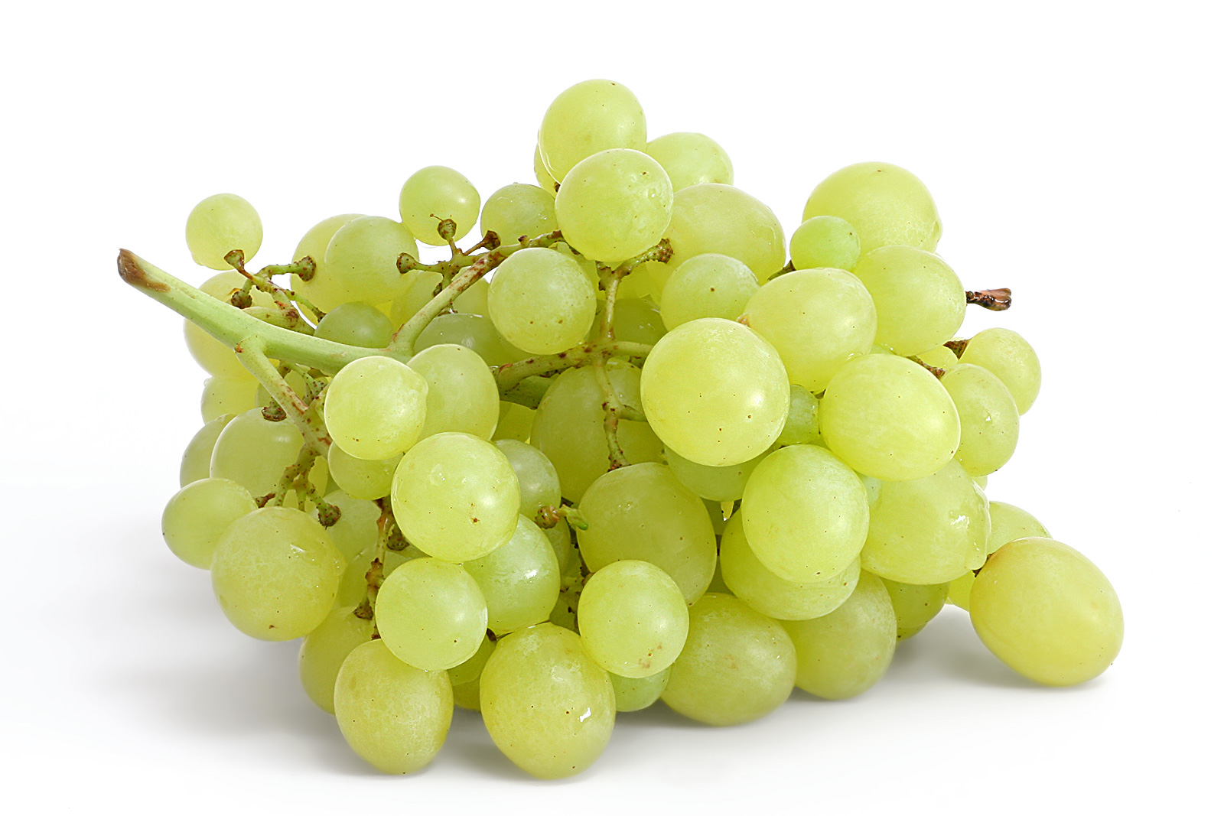
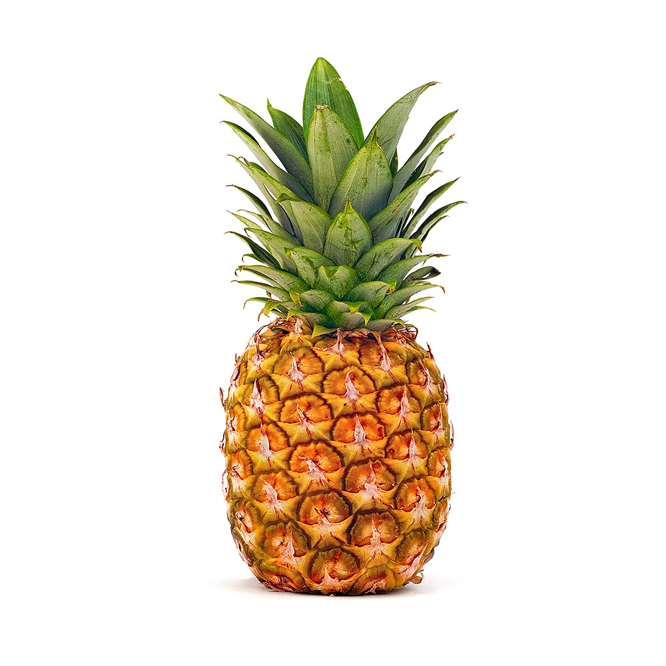
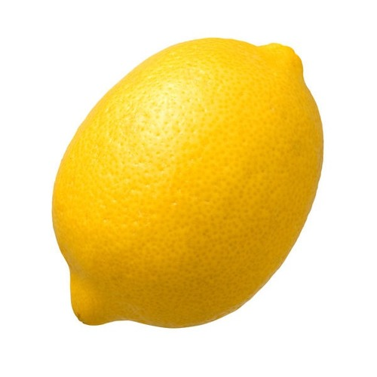
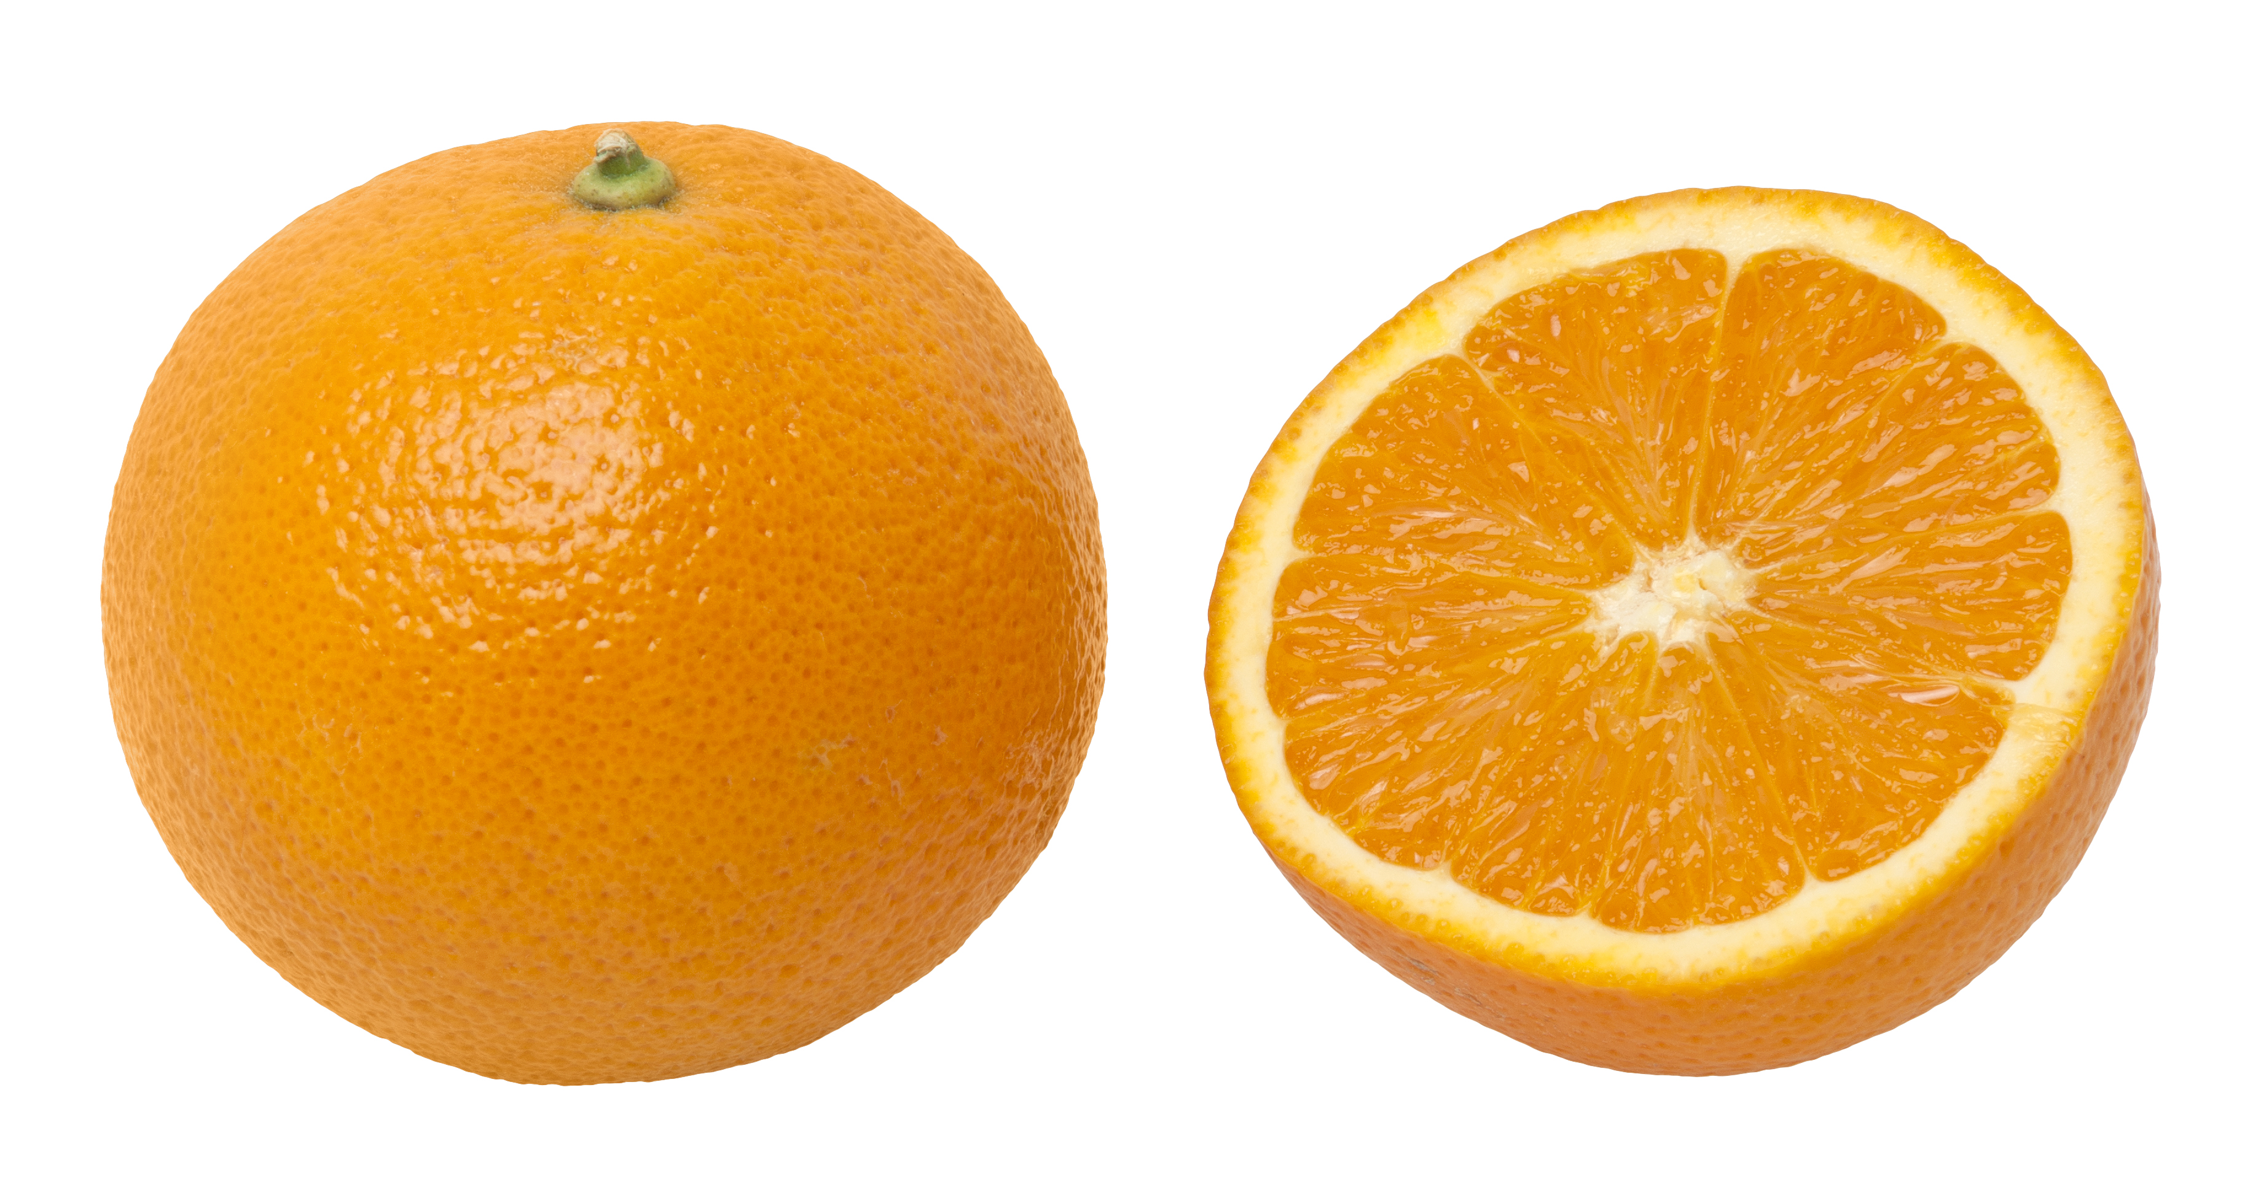
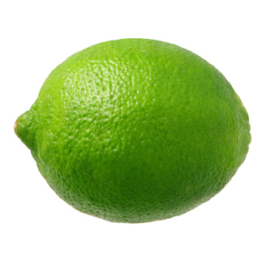
Let’s consider some fruits

Slide 7
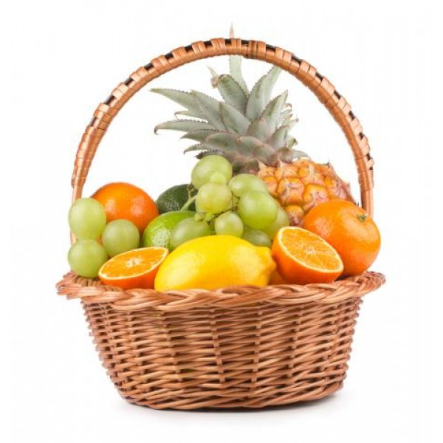
How can we carry them all together?

Slide 9
But how could we translate this to a notation using characters and not images?

Slide 10
Let’s open our exercises for today
https://github.com/JoanaBSilvestre/CodeClub

